Slide 1


MACHINE LEARNING FOR PHYSICS AND ASTRONOMY CHAPTER 2
Viviana Acquaviva

Slide 2
ALGORITHM #1: DECISION TREES

Slide 3
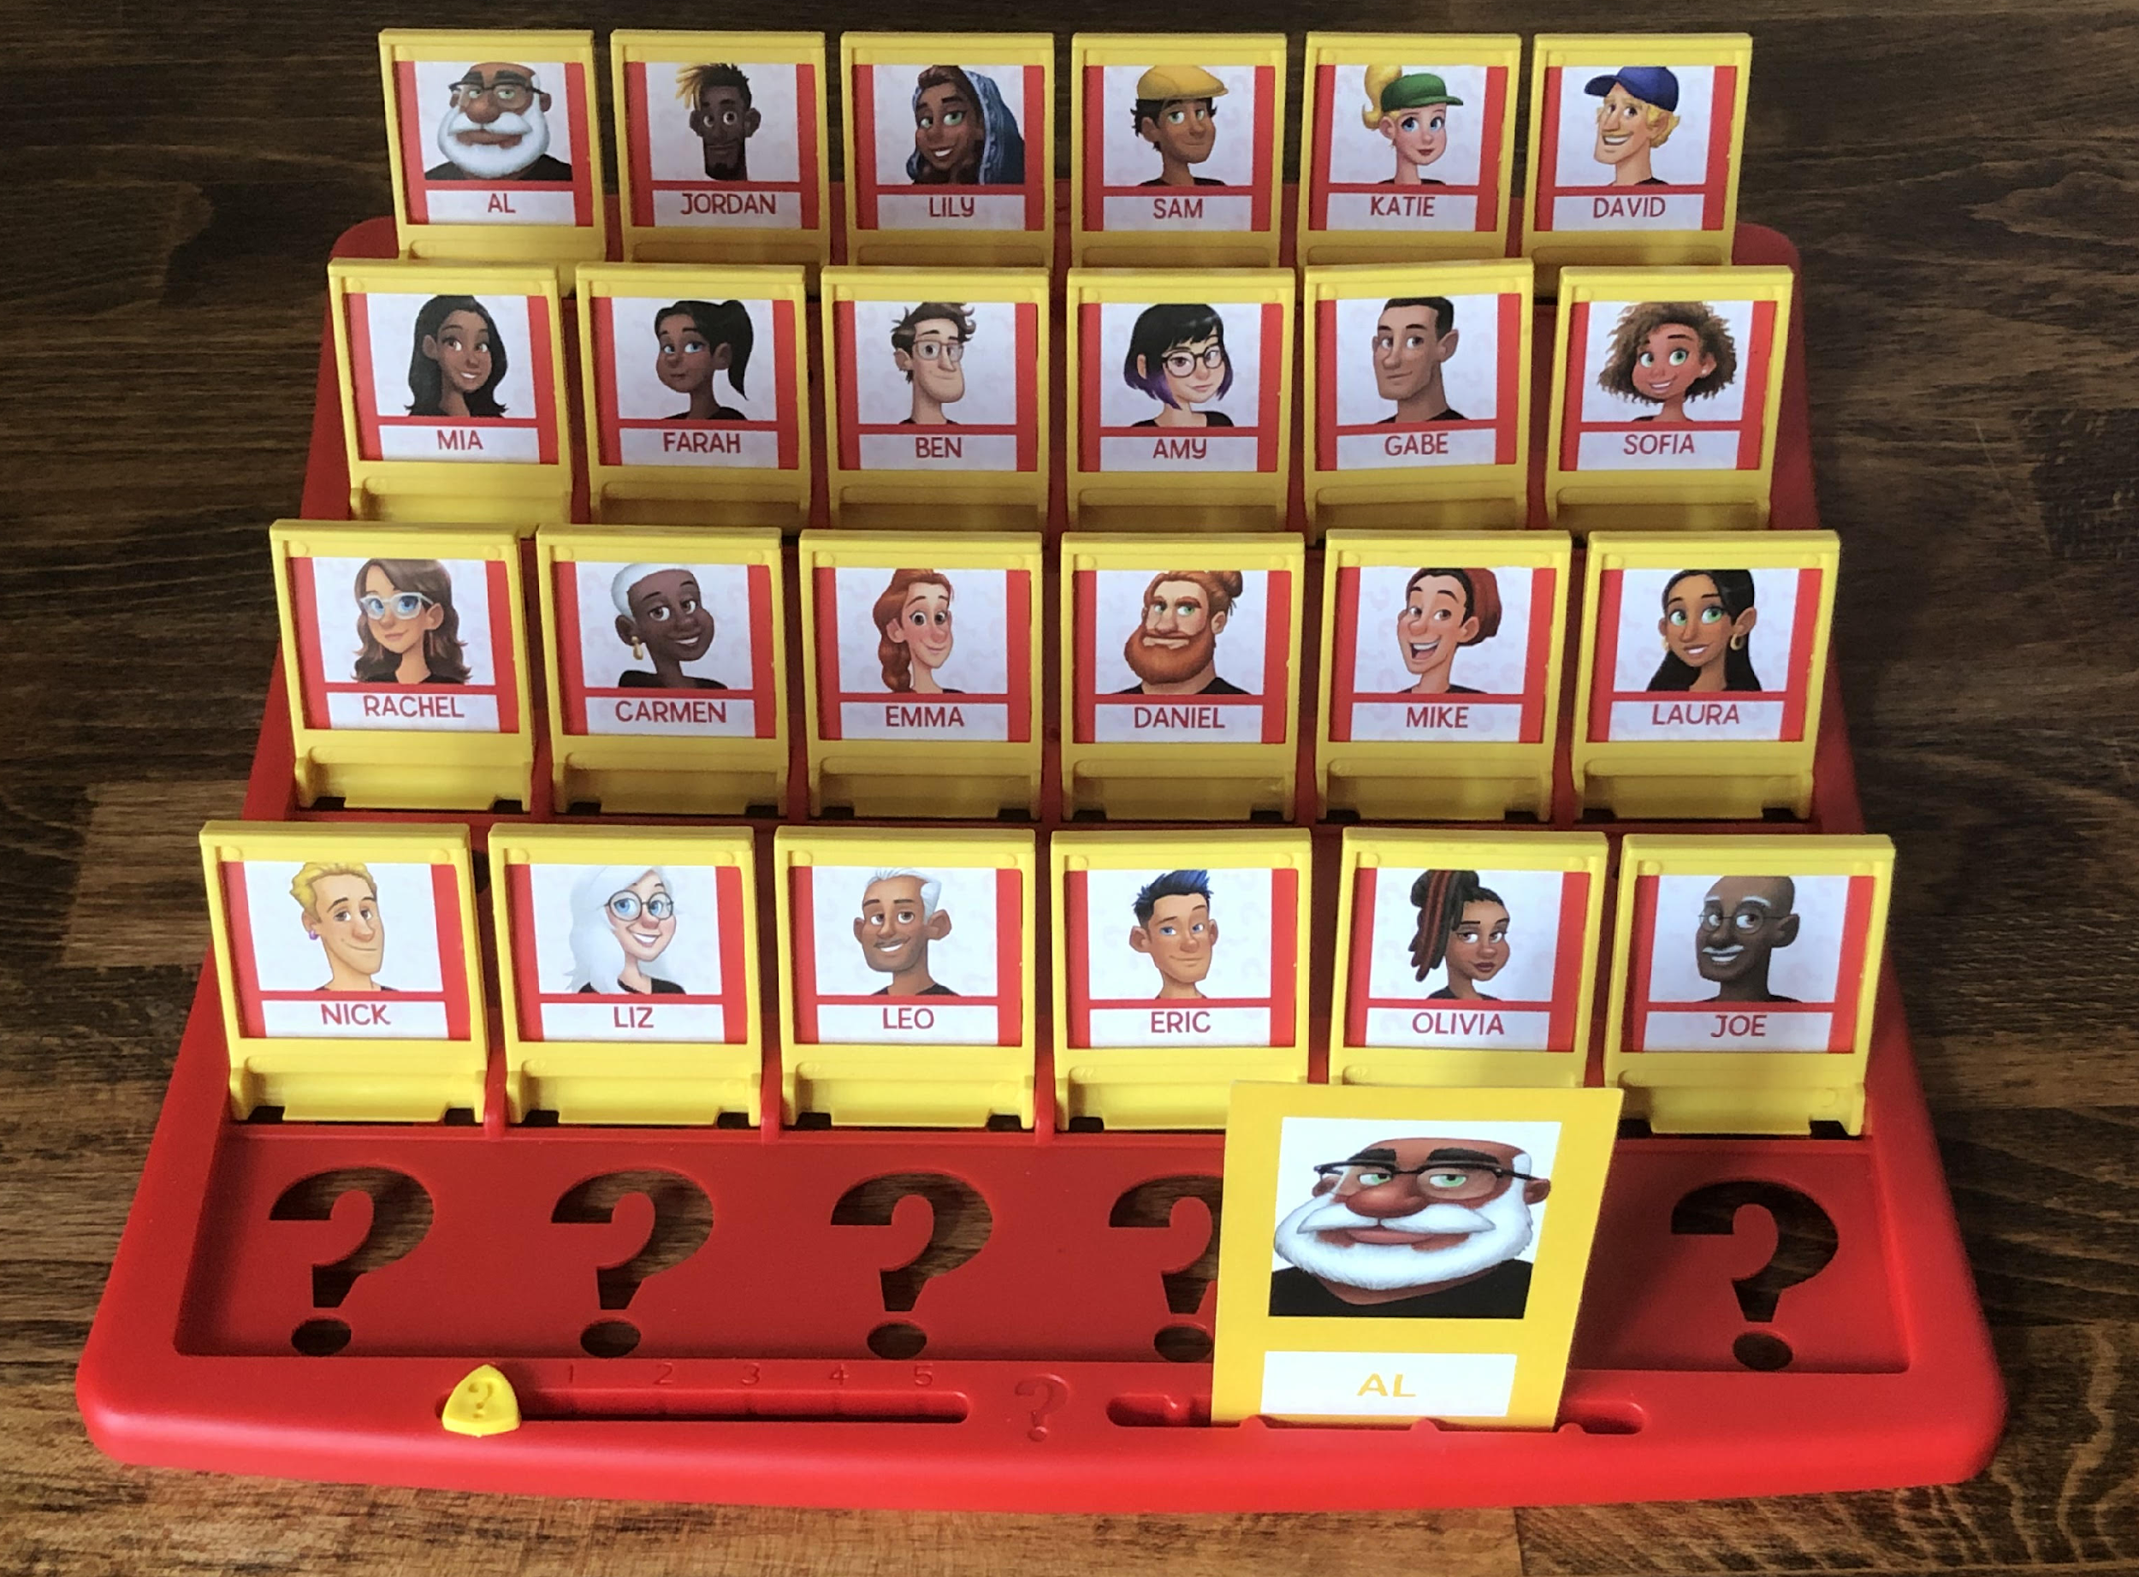
DECISION TREES
Work by splitting data on different values of features
Simplest trees are binary trees
If categorical features, the split would be on yes/no
If numerical, the split would be on a certain value (e.g. x > 100 or x < 100)
Notes:
Let’s figure out the features of the Guess Who problem.

Slide 4
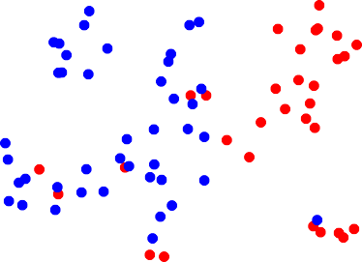
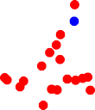
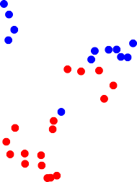
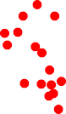
EXAMPLE: THIS 2-FEATURE DATA SET.
HOW SHOULD WE SPLIT?
X₂
Figure credit:
Gilles Louppe
X₁

Slide 5



EXAMPLE: THIS 2-FEATURE DATA SET.
HOW SHOULD WE SPLIT?
X₂
0.5
Figure credit:
Gilles Louppe
X₁

Slide 6
SHOULD WE STOP?
0.7
X₂
0.5
Figure credit:
Gilles Louppe
X₁

Slide 7





NODES (SPLITS AND LEAVES) DEFINE THE DECISION TREE
X₂
𝒙
t₄
Split node
t₅
𝑡₁
𝑋₂ ≤ 0.5 ?
>
<=
Leaf node
𝑡 ₂
≤ >
𝑋₁ ≤ 0.7 ?
𝑡 ₃
0.5
𝑡 ₄
𝑡 ₅
t₃
In a terminal node (leaf),
the model is ready to output a classification
(and all objects in that leaf have the same class)
0.7
X₁
Figure credit:
Gilles Louppe
Important questions:
How do we decide which splits to make, among the many
possible ones?
How do we decide whether we should stop?

Slide 8
BUILDING DECISION TREES
Find measure of impurity (e.g. Gini impurity) that we want to minimize.
Find splits that maximize decrease of impurity
Select stopping criterion as impurity < ε (e.g. , 0)
Gini (node L) = 1 - ∑ f(i)²
where f(i) is the frequency (=fractional abundance) of the i-th class
L_{L}/L * (1 - ∑ f(i)²)_{L} + L_{R}/L * (1 - ∑ f(i)²)_{R}
L = total # of objects in original split; L_{L} and L_{R} = # of objects in each of the new splits

Slide 9
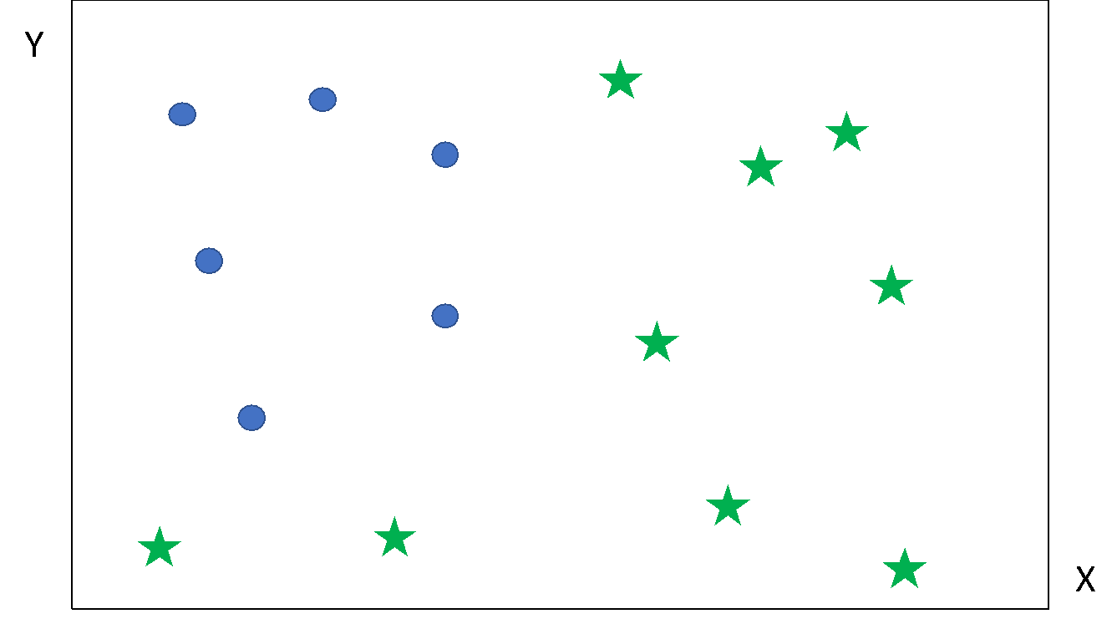
Which split should we do first?
Let’s calculate the Gini impurity in the original and each of the two.
L_{L}/L * (1 - ∑ f(i)²)_{L} + L_{R}/L * (1 - ∑ f(i)²)_{R}

Slide 10
(1 - ∑ f(i)²) =
1 – (6/15)^2 – (9/15)^2
= 0.48
L_{L}/L * (1 - ∑ f(i)²)_{L} + L_{R}/L * (1 - ∑ f(i)²)_{R}
= 4/15 * 0 + 11/15 * (1 – (6/11)^2 – (5/11)^2) = 0.363
L_{L}/L * (1 - ∑ f(i)²)_{L} + L_{R}/L * (1 - ∑ f(i)²)_{R}
= 7/15 * 0 + 8/15 * (1-(2/8)^2 – (6/8)^2) =
0.2

Slide 11
PSEUDO CODE FOR DECISION TREES
function BuildDecisionTree(L)
Create node t from the learning sample L_{t} = L; calculate (im)purity
if the stopping criterion is met for t then
stopping criterion
Gini (im)purity = 0
y^ = some constant value/class (MAKE PREDICTION)
Gini (node L) =
1 - ∑ f(i)²
where f(i) is the frequency of the i-th class
Gini (splits L_{L} and Lr) =
L_{L}/L * (1 - ∑ f(i)²) +
L_{R}/L * (1 - ∑ f(i)²)
where f(i) is the frequency of the i-th class
Note:
splits
happen
along (single) features!
t
else
Find the split on L_{t} that maximizes impurity decrease
s∗ = arg max ∆i (s, t)
s∈Q
Partition L_{t} into L_{tL} ∪ L_{tR} according to s∗
t_{L} = BuildDecisionTree(L_{L})
t_{R} = BuildDecisionTree(L_{R} )
end if
return t
end function
Code adapted from Gilles Louppe

Slide 12
OUR FIRST EXAMPLE WILL BE A SUPERVISED CLASSIFICATION PROBLEM, IN WHICH WE ATTEMPT TO PREDICT IF A PLANET IS HABITABLE, BASED ON ITS DISTANCE FROM PARENT STAR, MASS OF PARENT STAR, AND ORBITAL PERIOD.
We are now ready to build our first tree
(with pen and paper!)

Slide 13
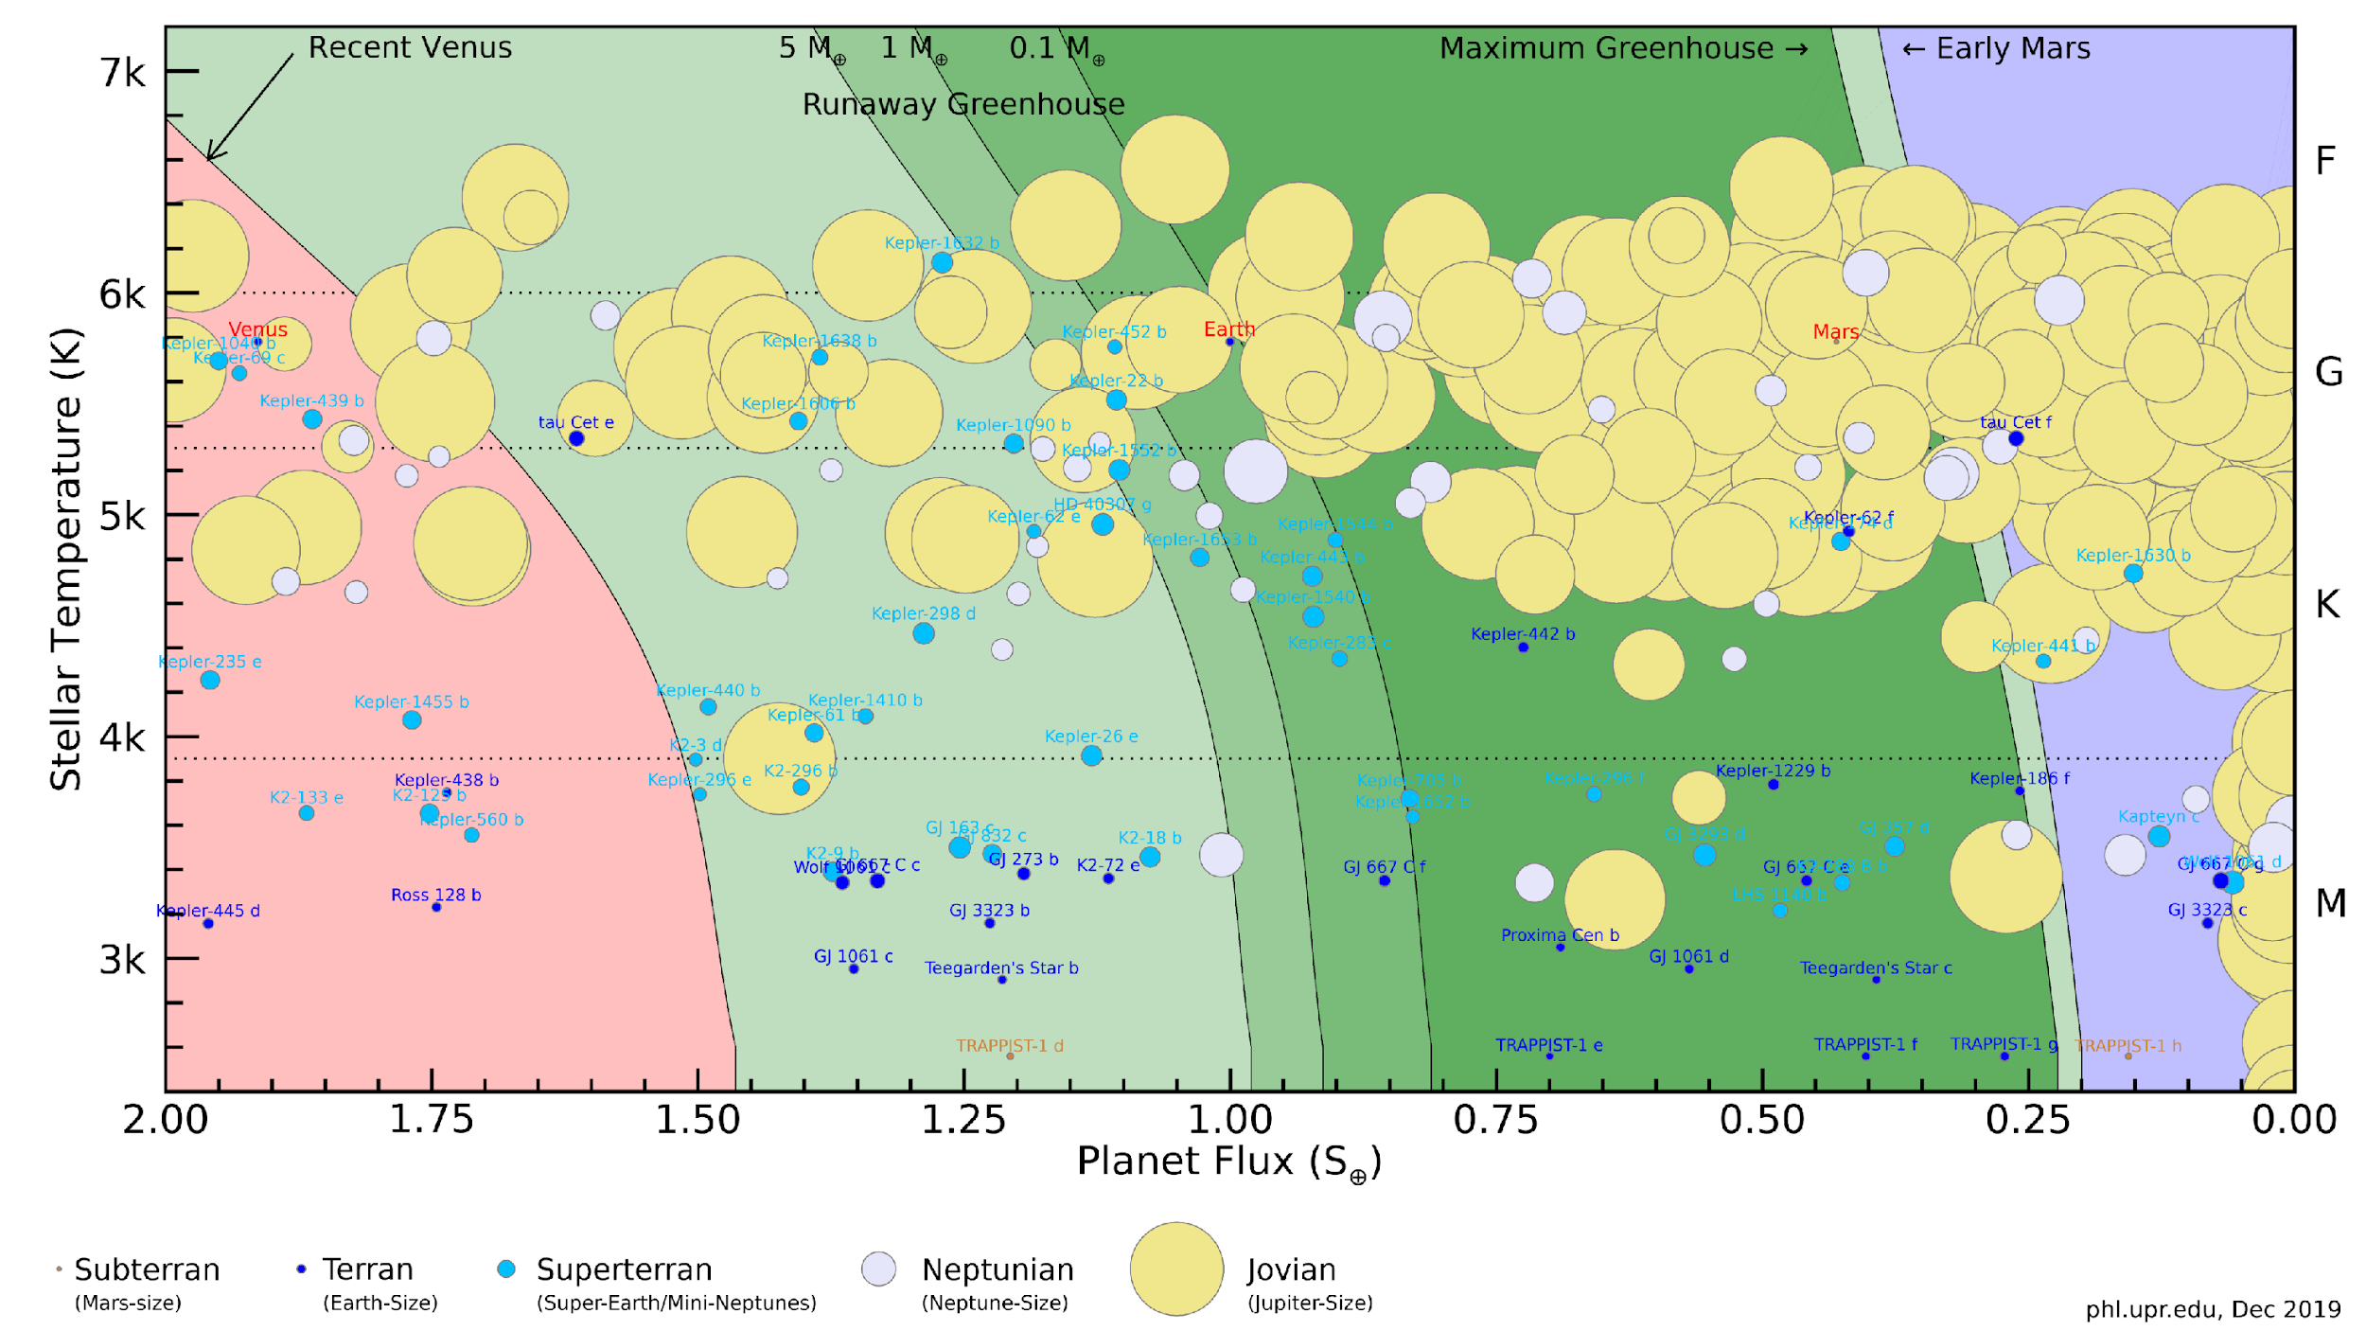
DATA FROM THE PLANET HABITABILITY LAB AT ARECIBO OBSERVATORY

Slide 14
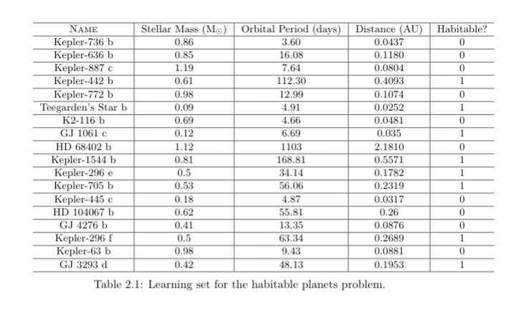

Slide 15
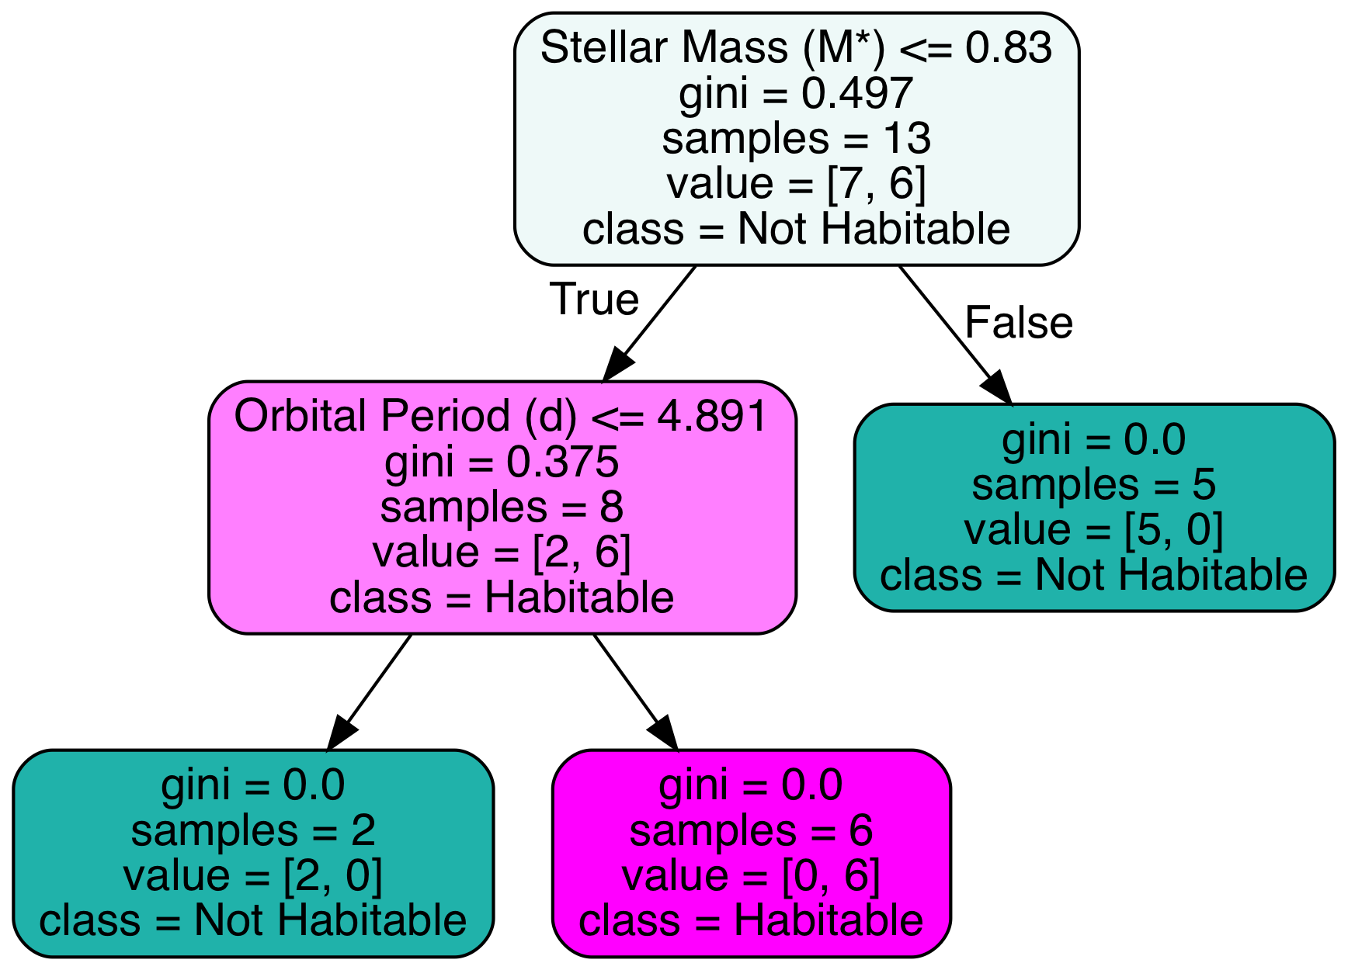
LET’S SEE WHAT SKLEARN SAYS
Notes:
Note: how would the Earth fare on this one?

Slide 16
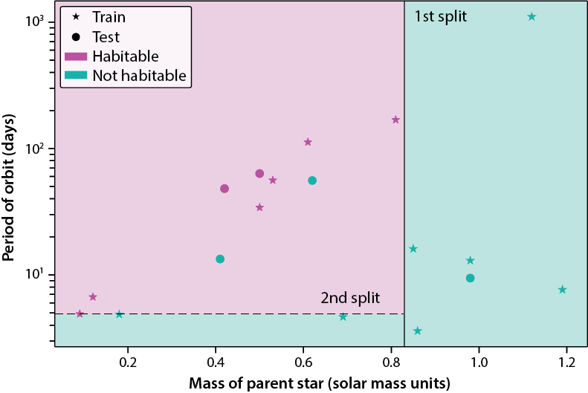
AND VISUALIZE THE CRITERIA THAT WE FOUND!
Can you figure out the accuracy on the test set?

Slide 17
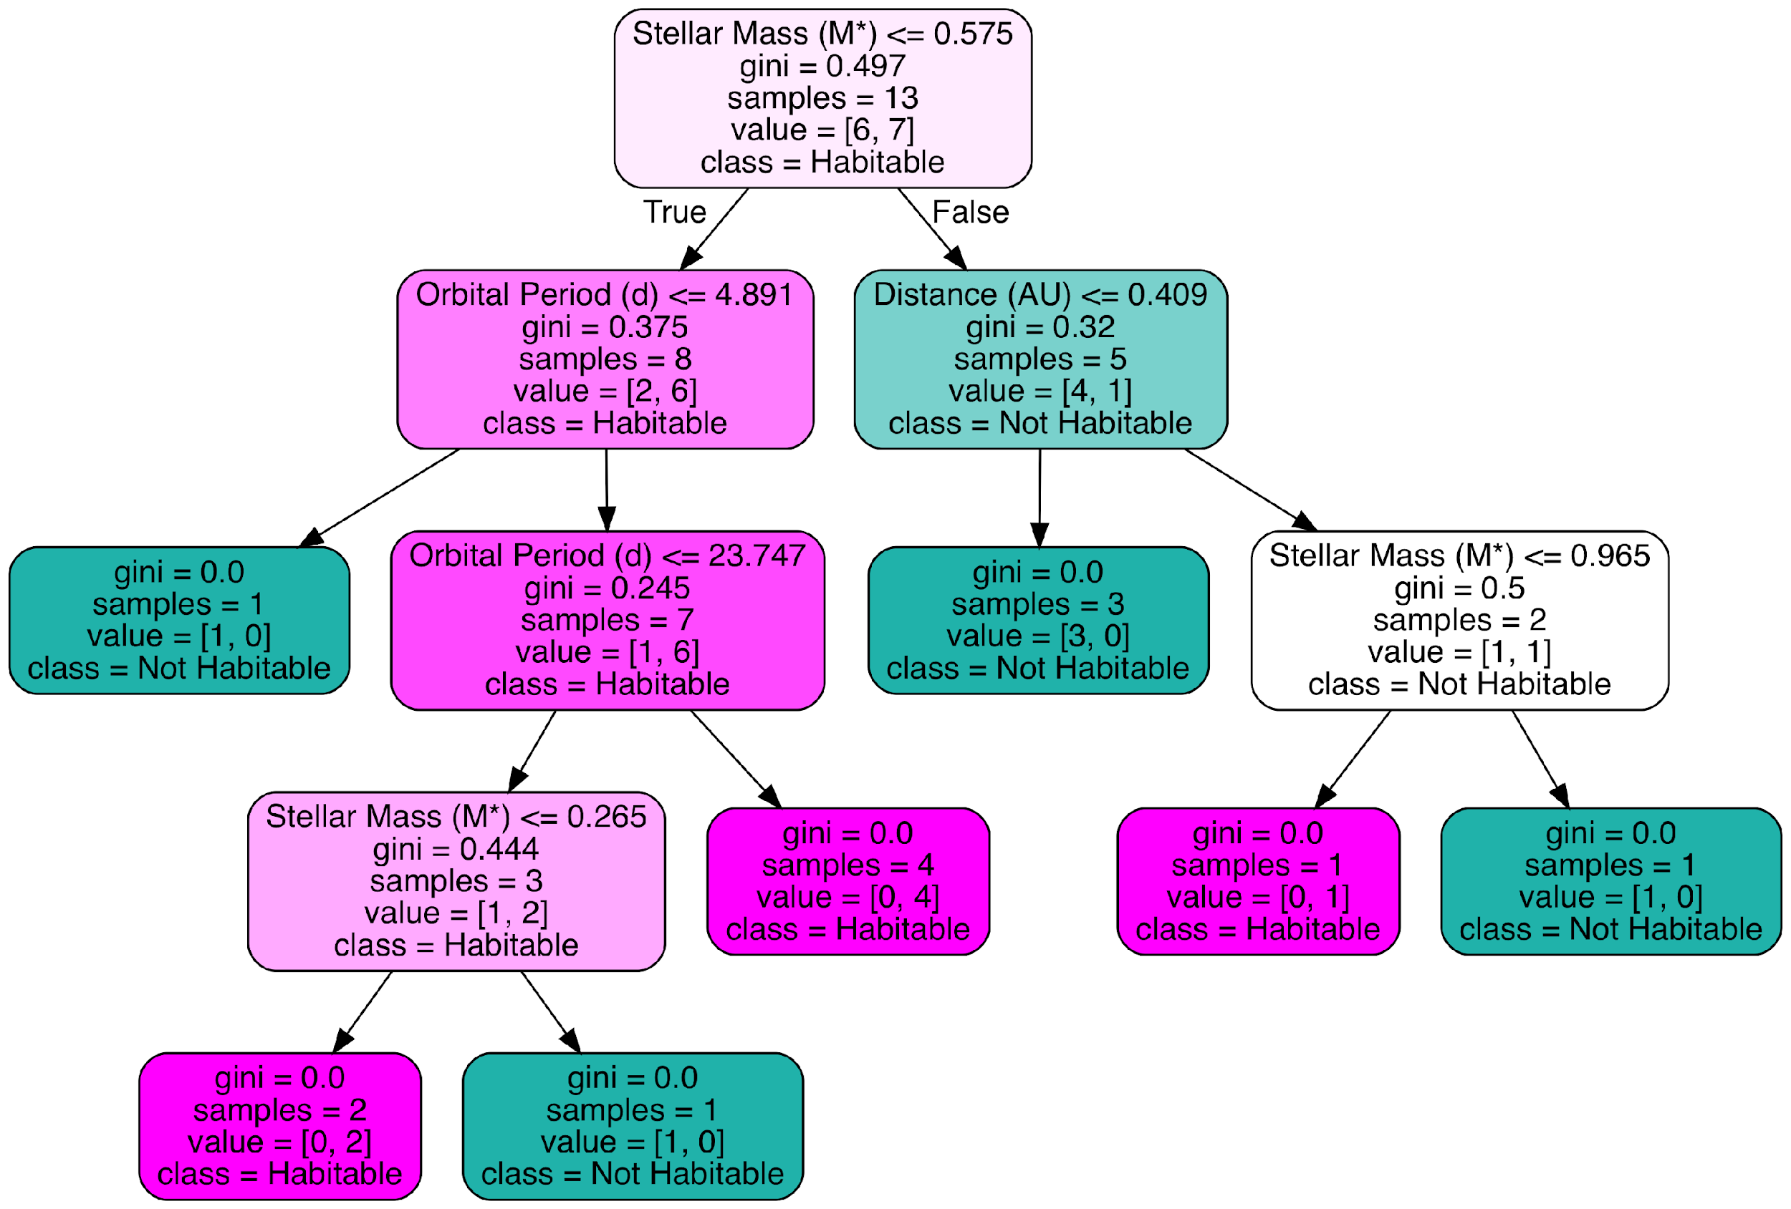
NOTE (AND WE’LL SEE CODE FOR IT): IF YOU USE THE LAST 13 ROWS FOR TRAINING AND THE FIRST 5 FOR TESTING, YOU GET THIS TREE:
and 100% accuracy on test set
Morale: Different train/test split might give significantly different performances,
especially when data sets are small.

Slide 18
KNN ALGORITHM (K NEAREST NEIGHBORS)
Simple, yet powerful!
Only one parameter: k (a small integer)
To make a prediction for a new object, find k closest examples in training set
For classification problems, output the majority class
For regression problems, output the mean of the target property

Slide 19
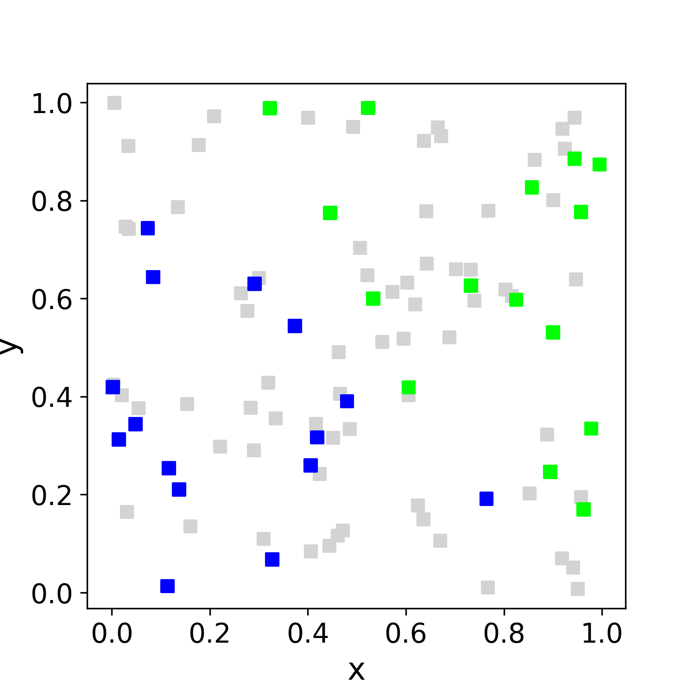
LET’S USE OUR OLD EXAMPLE. WHAT VALUE SHOULD WE USE FOR K?
k = 2
k = 5
odd is better!

Slide 20
TWEAKABLES!
1) Choose neighborhood radius instead of k
2) Weigh different objects according to distance (inverse-distance weighing)
Any insights on the effects of 1) and 2)?

Slide 21
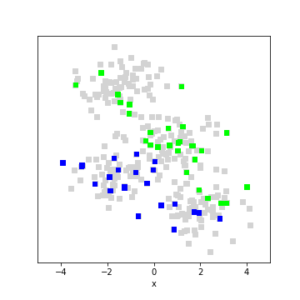
TWEAKABLES!
1) Choose neighborhood radius instead of k
2) Weigh different objects according to distance (inverse-distance weighing)
Any insights on the effects of 1) and 2)?
If the data have non-uniform density, different choices will have different effects! Needs to be chosen via cross-validation (next unit).

